Slide 1

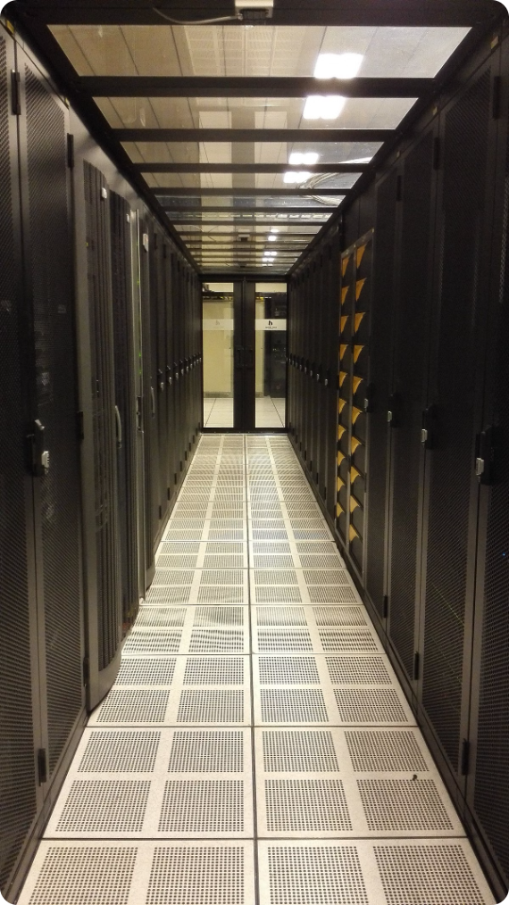
Optimizing Resource Allocation in an IaaS Environment
In today's dynamic IT landscape, organizations are increasingly adopting Infrastructure as a Service (IaaS) solutions to meet their evolving infrastructure needs. However, optimizing resource allocation within an IaaS environment presents a unique set of challenges. This presentation explores a comprehensive approach to address these challenges, leveraging advanced architectural design, user-friendly graphical interfaces, and robust programming techniques to achieve optimal resource utilization and cost efficiency.
PRANAV G
192224068

Slide 2

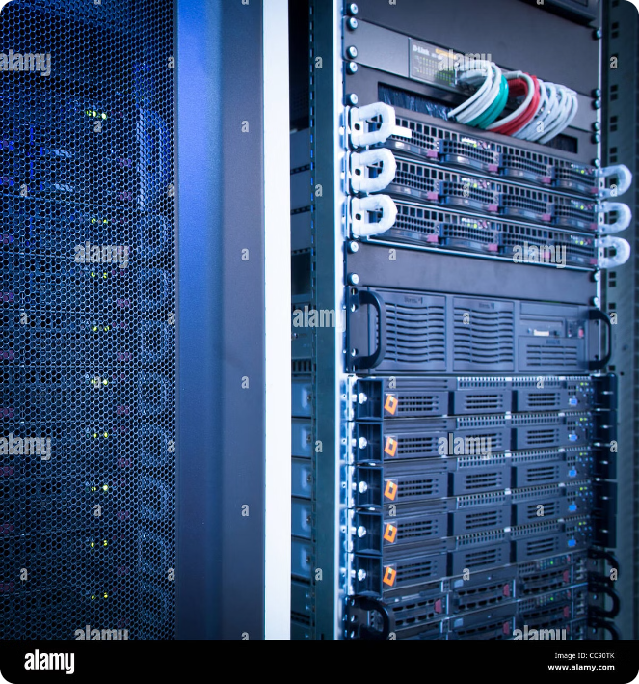
Aim, Scope & Problem Statement
The aim of this project is to develop a comprehensive system for optimizing resource allocation in an IaaS environment. The scope encompasses the identification of key components, the development of an architecture that ensures efficient resource utilization, and the creation of a user-friendly graphical interface for managing resource allocation. The primary problem statement revolves around the need to address the complexities of resource allocation within IaaS environments, including dynamic workloads, varying resource requirements, and the potential for over-provisioning, which can lead to increased costs and inefficient resource utilization.
1
Dynamic Workloads
In an IaaS environment, workloads can fluctuate significantly, leading to periods of high resource demand followed by periods of low utilization.
2
Varying Resource Requirements
Different applications and services have varying resource requirements, ranging from simple web applications to demanding data processing tasks.
3
Over-Provisioning
To ensure availability, organizations often over-provision resources, leading to wasted capacity and increased costs.
4
Cost Optimization
The ability to dynamically adjust resource allocation based on demand is crucial for cost optimization in an IaaS environment.

Slide 3
Proposed Architecture Design
The proposed architecture design for resource allocation optimization in an IaaS environment consists of several key components working together to provide a comprehensive solution. These components include a resource monitoring and analysis module, an intelligent resource allocation engine, a user interface, and an integration with the chosen IaaS provider's API. The architecture is designed to be flexible and scalable, allowing for easy adaptation to different IaaS platforms and evolving business needs.
Resource Monitoring and Analysis Module
Intelligent Resource Allocation Engine
User Interface
A user-friendly interface enables administrators to monitor resource usage, set resource allocation policies, and manage the overall system.
This module continuously gathers data on resource utilization, including CPU, memory, storage, and network bandwidth. It analyzes this data to identify patterns, trends, and potential bottlenecks.
The core of the architecture, this engine utilizes machine learning algorithms and predictive analytics to determine the optimal allocation of resources based on real-time data and historical trends.

Slide 4

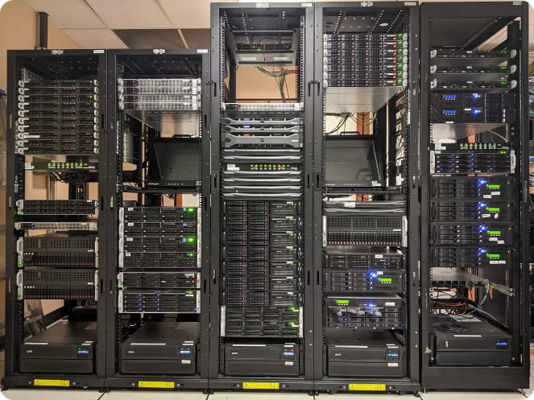
Identifying Key Components
The success of any system relies on the identification and implementation of key components that work together to achieve the desired outcome. In this context, the key components of the proposed architecture for resource allocation optimization in an IaaS environment include a resource monitoring and analysis module, an intelligent resource allocation engine, a user interface, and an integration with the chosen IaaS provider's API.
Resource Monitoring and Analysis Module
This component plays a critical role in gathering real-time data on resource usage, including CPU, memory, storage, and network bandwidth. This data is then analyzed to identify patterns, trends, and potential bottlenecks.
Intelligent Resource Allocation Engine
This component is responsible for making intelligent decisions about resource allocation. It utilizes machine learning algorithms and predictive analytics to optimize resource utilization based on real-time data and historical trends.
User Interface
A user-friendly interface provides administrators with a centralized platform to monitor resource usage, set resource allocation policies, and manage the overall system.
IaaS Provider API Integration
This integration allows the system to interact with the chosen IaaS provider's API, enabling it to dynamically provision, scale, and de-provision resources based on the allocation decisions made by the intelligent resource allocation engine.

Slide 5
Functionality
The proposed architecture for optimizing resource allocation in an IaaS environment is designed to provide a comprehensive set of functionalities that address the key challenges of resource management in cloud environments. These functionalities include real-time resource monitoring, intelligent resource allocation, dynamic scaling, cost optimization, and user-friendly management tools.
Real-Time Resource Monitoring
1
The system continuously monitors resource usage across all deployed resources, providing real-time insights into current resource consumption and potential bottlenecks.
2
Intelligent Resource Allocation
Utilizing machine learning algorithms, the system analyzes historical data and real-time usage patterns to determine the optimal allocation of resources for each application or service.
Dynamic Scaling
3
The system automatically scales resources up or down based on real-time demand, ensuring optimal utilization and cost efficiency.
4
Cost Optimization
By minimizing over-provisioning and dynamically adjusting resource allocation based on demand, the system significantly reduces overall infrastructure costs.
User-Friendly Management Tools
5
A user-friendly interface allows administrators to easily monitor resource usage, set allocation policies, and manage the system with minimal effort.

Slide 6





Architectural Design
The architectural design of the system is based on a layered approach, with each layer responsible for specific functionalities. The bottom layer interacts directly with the IaaS provider's API, enabling dynamic provisioning and management of resources. The middle layer houses the intelligent resource allocation engine, which analyzes real-time data and historical patterns to determine optimal resource allocation. The top layer provides a user-friendly interface for administrators to monitor resource usage, set allocation policies, and manage the overall system.
Layer 1: IaaS Provider API Integration
This layer handles communication with the chosen IaaS provider's API, enabling the system to dynamically provision, scale, and de-provision resources based on the allocation decisions made by the intelligent resource allocation engine.
Layer 2: Intelligent Resource Allocation Engine
This layer utilizes machine learning algorithms and predictive analytics to analyze real-time data and historical trends to determine the optimal allocation of resources based on current demand and expected future usage patterns.
Layer 3: User Interface
This layer provides a user-friendly interface for administrators to monitor resource usage, set resource allocation policies, and manage the overall system.

Slide 7

GUI Design
The graphical user interface (GUI) is designed to be intuitive and user-friendly, providing administrators with a comprehensive overview of resource usage, allocation policies, and system performance. The interface incorporates color-coding and visual cues to highlight potential bottlenecks, resource over-provisioning, and areas for optimization. Key elements of the GUI include a dashboard for real-time resource monitoring, a policy management section, a history view, and a reporting module.
Element
Description
Dashboard
Provides a real-time overview of resource utilization across all deployed resources, including CPU, memory, storage, and network bandwidth.
Policy Management
Enables administrators to set resource allocation policies based on specific applications, services, or user groups, ensuring that resources are allocated according to defined business requirements.
History View
Provides historical data on resource usage, allowing administrators to track trends, identify patterns, and evaluate the effectiveness of implemented policies.
Reporting Module
Generates comprehensive reports on resource usage, cost optimization, and system performance, providing valuable insights for decision-making and optimization.

Slide 8





Program/Coding
The implementation of the intelligent resource allocation engine requires a robust programming language that provides the necessary functionalities for data analysis, machine learning, and API integration. Python is a popular choice for this task, offering a rich ecosystem of libraries for data science, machine learning, and cloud integration.
Cloud Integration
The system utilizes the chosen IaaS provider's API to interact with the cloud infrastructure, enabling dynamic provisioning, scaling, and de-provisioning of resources based on the decisions made by the intelligent resource allocation engine.
Data Analysis & Machine Learning
Python libraries such as Pandas, NumPy, and Scikit-learn provide powerful tools for data analysis, feature engineering, and the development of machine learning models to predict resource demand and optimize allocation.
Code Development & Maintenance
Python's clear syntax, extensive documentation, and robust community support make it an ideal choice for developing and maintaining the codebase of the intelligent resource allocation engine.

Slide 9


Implementation
The implementation of the proposed architecture for optimizing resource allocation in an IaaS environment involves a series of steps that ensure a smooth and successful deployment. These steps include connecting the components, deploying the system on the chosen IaaS platform, and rigorously testing the system to ensure its functionality and performance.
1
Connecting the Components
The various components of the system, including the resource monitoring and analysis module, the intelligent resource allocation engine, the user interface, and the IaaS provider API integration, need to be seamlessly connected to enable data flow and communication.
2
Cloud Deployment
The system is deployed on the chosen IaaS platform, leveraging the provider's infrastructure and services. This deployment process ensures that the system is fully integrated with the cloud environment and can efficiently manage resources.
3
Project Testing
Rigorous testing is conducted to ensure the functionality and performance of the system. This includes unit testing of individual components, integration testing to verify interactions between components, and performance testing to evaluate the system's ability to handle real-world workloads.

Slide 10

Conclusion
In conclusion, the implementation of the proposed architecture for optimizing resource allocation in an IaaS environment has been thoroughly explored. The key components have been identified, and the functionality, architectural design, and GUI design have been meticulously planned.
The final step involves the actual program development and coding, followed by comprehensive testing to ensure the system's seamless integration and optimal performance in the cloud environment.

